Slide 1
Unit - IV

Slide 2
Vehicle Motion Control
The term vehicle motion refers to its translation along and rotation about all three axes (i.e., longitudinal, lateral, and vertical).
By the term longitudinal axis, we mean the axis that is parallel to the ground (vehicle at rest) along the length of the car.
The lateral axis is orthogonal to the longitudinal axis and is also parallel to the ground (vehicle at rest).
The vertical axis is orthogonal to both the longitudinal and lateral axes.
Rotations of the vehicle around these three axes correspond to angular displacement of the car body in roll, yaw, and pitch.

Slide 3
Vehicle Motion Control contd……
Roll refers to angular displacement about the longitudinal axis;
yaw refers to angular displacement about the vertical axis; and
pitch refers to angular displacement about the lateral axis.
Electronic controls have been developed with the capability to regulate the motion along and about all three axes.
The forces that influence vehicle motion along the longitudinal axis include the power-train (including traction control), the brakes, the aerodynamic drag, and tire-rolling resistance, as well as the influence of gravity when the car is moving on a road with a nonzero inclination (or grade).

Slide 4
Typical Cruise Control System
Automotive cruise control is an excellent example of the type of electronic feedback control system.
The components of a control system include the plant, or system being controlled, and a sensor for measuring the plant variable being regulated.
It also includes an electronic control system that receives inputs in the form of the desired value of the regulated variable and the measured value of that variable from the sensor.
The control system generates an error signal constituting the difference between the desired and actual values of this variable.

Slide 5
Typical Cruise Control System contd……
It then generates an output from this error signal that drives an electromechanical actuator.
The actuator controls the input to the plant in such a way that the regulated plant variable is moved toward the desired value.
In the case of a cruise control, the variable being regulated is the vehicle speed.
The driver manually sets the car speed at the desired value via the accelerator pedal.
Upon reaching the desired speed the driver activates a momentary contact switch that sets that speed as the command input to the control system.
From that point on, the cruise control system maintains the desired speed automatically by operating the throttle via a throttle actuator.

Slide 6
Typical Cruise Control System contd……
Under normal driving circumstances, the total drag forces acting on the vehicle are such that a net positive traction force from the power-train is required to maintain a constant vehicle speed.
However, when the car is on a downward sloping road of sufficient grade, constant vehicle speed requires a negative tractive force that the powertrain can’t deliver.
In this case, the car will accelerate unless brakes are applied.
The plant being controlled consists of the powertrain, which drives the vehicle through the drive axles and wheels.
The load on this plant includes friction and aerodynamic drag as well as a portion of the vehicle weight when the car is going up and down hills.

Slide 7
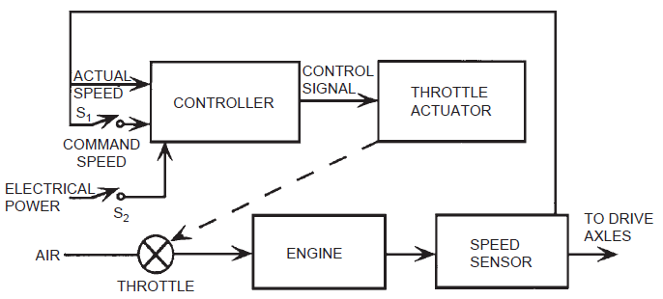
Typical Cruise Control System contd……
The configuration for a typical automotive cruise control is shown below:

Slide 8
Typical Cruise Control System contd……
The momentary contact switch that sets the command speed is denoted S₁.
Also shown is a disable switch that completely disengages the cruise control system from the power supply such that throttle control reverts back to the accelerator pedal.
This switch is denoted S₂ and is a safety feature.
The throttle actuator opens and closes the throttle in response to the error between the desired and actual speed.
Whenever the actual speed is less than the desired speed the throttle opening is increased by the actuator, which increases vehicle speed until the error is zero, at which point the throttle opening remains fixed until either a disturbance occurs or the driver calls for a new desired speed.

Slide 9
Antilock Braking System
ABS is a safety-related feature that assists the driver in deceleration of the vehicle in poor or marginal braking conditions (e.g., wet or icy roads).
In such conditions, panic braking by the driver (in non-ABS-equipped cars) results in reduced braking effectiveness and, typically, loss of directional control due to the tendency of the wheels to lock.
In ABS-equipped cars, the wheel is prevented from locking by a mechanism that automatically regulates braking force to an optimum for any given low-friction condition.
The physical configuration for an ABS is shown.

Slide 10
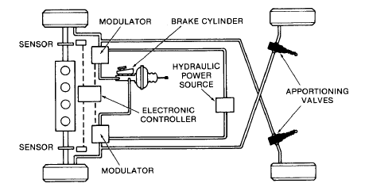
Antilock Braking System contd……

Slide 11
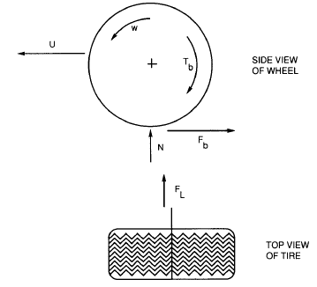
Antilock Braking System contd……
In addition to the normal brake components, including brake pedal, master cylinder, vacuum boost, wheel cylinders, calipers/disks, and brake lines, this system has a set of angular speed sensors at each wheel, an electronic control module, and a hydraulic brake pressure modulator (regulator).
Figure illustrates the forces applied to the wheel by the road during braking.

Slide 12

Antilock Braking System contd……
The car is traveling at a speed U and the wheels are rotating at an angular speed ω where
and where RPM is the wheel revolutions per minute.
When the wheel is rolling (no applied brakes),
where R is the tire radius.
When the brake pedal is depressed, the calipers are forced by hydraulic pressure against the disk.

Slide 13

Antilock Braking System contd……
This force acts as a torque T_{b} in opposition to the wheel rotation.
The actual force that decelerates the car is shown as F_{b}.
The lateral force that maintains directional control of the car is shown as F_{L}.
The wheel angular speed begins to decrease, causing a difference between the vehicle speed U and the tire speed over the road (i.e., ωR).
In effect, the tire slips relative to the road surface.
The amount of slip (S) determines the braking force and lateral force.
The slip, as a percentage of car speed, is given by

Slide 14
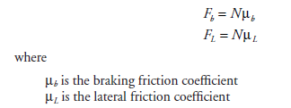
Antilock Braking System contd……
The braking and lateral forces are proportional to the normal force (from the weight of the car) acting on the tire/road interface (N) and the friction coefficients for braking force (F_{b}) and lateral force (F_{L}):
These coefficients depend markedly on slip.

Slide 15
Antilock Braking System contd……
In ABS-equipped cars under marginal or poor braking conditions, the driver simply applies a steady brake force and the system adjusts tire slip to optimum value automatically.
During heavy braking under marginal conditions, sufficient braking force is applied to cause wheel lock-up (in the absence of ABS control).
Consequently, the wheel torque reaches a maximum value.
After the peak wheel torque is sensed electronically, the electronic control system commands that brake pressure be reduced (via the brake pressure modulator).

Slide 16
Electronic Suspension System
Automotive suspension systems consist of springs, shock absorbers, and various linkages to connect the wheel assembly to the car frame.
The purpose of the suspension system is to isolate the car body motion as much as possible from wheel motion due to rough road input.
The performance of the suspension system is strongly influenced by the damping parameter of the shock absorber.
In electronically controlled suspension systems, this damping can be varied depending on driving conditions and road roughness characteristics.
That is, the suspension system adapts to inputs to maintain the best possible ride subject to handling constraints that are associated with safety.

Slide 17
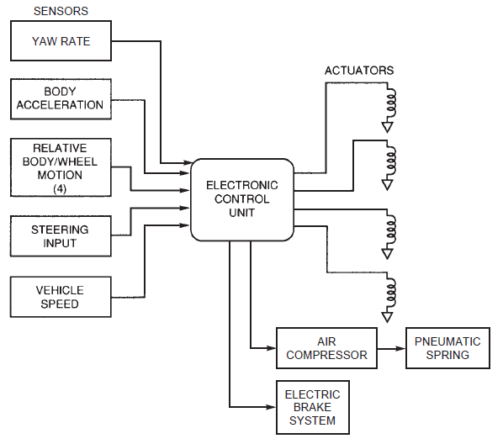
Electronic Suspension System contd……
The control system for a typical electronic suspension system is shown in the block diagram.
This system includes sensors for measuring vehicle speed; steering input (i.e., angular deflection of steered wheels); relative displacement of the wheel assembly and car body/chassis; lateral acceleration; and yaw rate.

Slide 18
Electronic Suspension System contd……
The outputs are electrical signals to the shock absorber/strut actuators and to the motor/compressor that pressurizes the pneumatic springs.
The actuators can be solenoid-operated orifices or motor-driven variable orifices or electromagnets for RH fluid-type variable viscosity struts.
Control system is in the form of a microprocessor-based digital controller.
The inputs from sensors are sampled, converted to digital format, and stored.
The relative body/wheel motion can be used to estimate tire normal force, and damping is then adjusted to try to optimize this normal force.

Slide 19
Electronic Suspension System contd……
The yaw rate sensor provides data which, in relationship to vehicle speed and steering input measurements, can be used to evaluate cornering performance.
In certain vehicles, these measurements combine in an algorithm that is used to activate the electro-hydraulic brakes.
Under program control in accordance with the control strategy, the electronic control system generates output electrical signals to the various actuators.
The variable damping actuators vary either the oil passage orifice or the RH fluid viscosity independently at each wheel to obtain the desired damping for that wheel.

Slide 20
Electronic Steering Control
The steering effort required of the driver to overcome restoring torque, generally decreases with vehicle speed and increases with steering angle.
Traditionally, the steering effort required by the driver has been reduced by incorporating a hydraulic power steering system in the vehicle.
Whenever there is a steering input from the driver, hydraulic pressure from an engine-driven pump is applied to a hydraulic cylinder that boosts the steering effort of the driver.
Typically, the effort available from the pump increases with engine speed (i.e., with vehicle speed), whereas the required effort decreases.

Slide 21
Electronic Steering Control contd……
Using electronic control of power steering, the available steering boost is reduced by controlling a pressure relief valve on the power steering pump.
An alternative power steering scheme utilizes a special electric motor to provide the boost required instead of the hydraulic boost.
Electronic control of electric boost systems is straightforward and can be accomplished without any energy conversion from electrical power to mechanical actuation.
Moreover, electronic control offers very sophisticated adaptive control in which the system can adapt to the driving environment.

Slide 22
Electronic Steering Control contd……
In the four-wheel steering systems (4WS) equipped vehicles, the front wheels are directly linked mechanically to the steering wheel, as in traditional vehicles.
There is a power steering boost for the front wheels as in a standard two-wheel steering system.
The rear wheels are steered under the control of a microcontroller via an actuator.
The 4WS configuration is shown.
The front wheels are steered to a steering angle δ_{f} by the driver’s steering wheel input.
A sensor (S) measures the steering angle and another sensor (U) gives the vehicle speed.

Slide 23
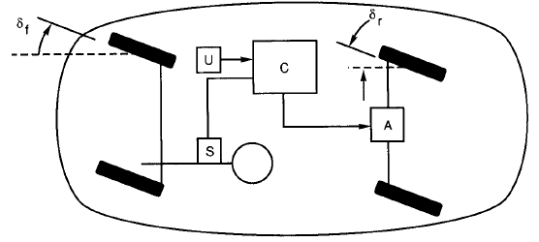
Electronic Steering Control contd……
The microcontroller (C) determines the desired rear steering angle δ_{r} under program control as a function of speed and front steering angle.

Slide 24
Electronic Steering Control contd……
For speeds below 10 mph, the rear steering angle is in the opposite direction to the front steering angle.
This control strategy has the effect of decreasing the car’s turning radius by as much as 30% from the value it has for front wheel steering only.
Consequently, the maneuvering ability of the car at low speeds is enhanced.
At intermediate speeds (e.g., 11mph < U < 30mph), the steering might be front wheel only.
At higher speeds (including highway cruise), the front and rear wheels are steered in the same direction.

Slide 25
Electronic Steering Control contd……
At least one automaker has an interesting strategy for higher speeds (e.g., at highway cruise speed).
In this strategy, the rear wheels turn in the opposite direction to the front wheels for a very short period (on the order of one second) and then turn in the same direction as the front wheels.
This strategy has a beneficial effect on maneuvers such as lane changes on the highway.
Figure illustrates the lane change for front wheel steering and for this latter 4WS strategy, in which the same front steering angle was used.

Slide 26
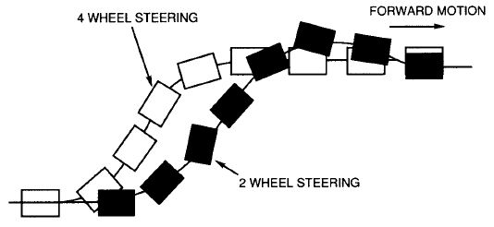
Electronic Steering Control contd……
Notice that the 4WS strategy yields a lane change in a shorter distance and avoids the overshoot common in a standard-steering vehicle.

Slide 27
Electronic Steering Control contd……
Turning the wheels in the same direction at cruising speeds has another benefit for a vehicle towing a trailer.
When front and rear wheels turn in the same direction, the angle between the car and trailer axes is less than it is for front wheel steering only.
The reduction in this angle means that the lateral force applied to the rear wheels by the trailer in curves is less than that for front wheel only steering.
This lateral force reduction improves the stability of the car or truck/trailer combination relative to front steering only.

Slide 28
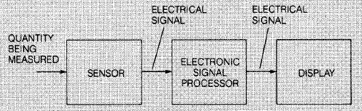
Modern Automotive Instrumentation
General block diagram for instrumentation is shown.
In electronic instrumentation, a sensor is required to convert any nonelectrical signal to an equivalent voltage or current.
Electronic signal processing is then performed on the sensor output to produce an electrical signal that is capable of driving the display device.
The display device is read by the vehicle driver.
If a quantity to be measured is already in electrical form, this signal can be used directly and no sensor is required.

Slide 29
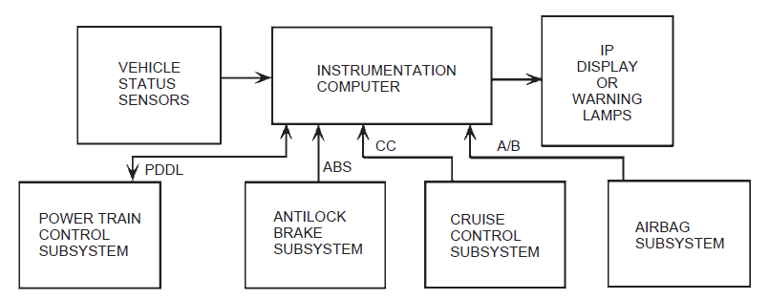
Modern Automotive Instrumentation contd……
A block diagram of computer-based instrumentation system is shown.

Slide 30
Modern Automotive Instrumentation contd……
All measurements from the various sensors and switches are processed in a special-purpose digital computer.
The processed signals are routed to the appropriate display or warning message.
This display is termed as the instrument panel (IP).
The inputs to the instrumentation computer include sensors (or switches) for measuring (or sensing) various vehicle variables as well as diagnostic inputs from the other critical electronic subsystems.

Slide 31
Modern Automotive Instrumentation contd……
The vehicle status sensors may include any of the following:
1. Fuel quantity
2. Fuel pump pressure
3. Fuel flow rate
4. Vehicle speed
5. Oil pressure
6. Oil quantity
7. Coolant temperature
8. Outside ambient temperature
9. Windshield washer fluid quantity
10. Brake fluid quantity

Slide 32
Modern Automotive Instrumentation contd……
In addition to these variables, the input may include switches for detecting open doors and trunk, as well as IP selection switches for multifunction displays that permit the driver to select from various display modes or measurement units.
An important function of modern instrumentation systems is to receive diagnostic information from certain subsystems and to display appropriate warning messages to the driver.

Slide 33
Input and Output Signal Conversion
Any single input can be either digital switched or analog, depending on the technology used for the sensor.
A typical instrumentation computer is designed to accept all of these input formats.
A typical system is designed with a separate input from each sensor or switch.
The analog inputs must all be converted to digital format using an analog to digital (A/D) converter.
Analog-to-Digital conversion is shown.
The digital inputs are already in the desired format.
The conversion process requires an amount of time that depends primarily on the A/D converter.

Slide 34
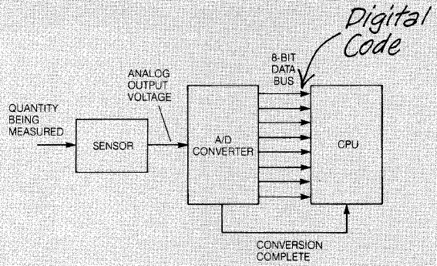
Input and Output Signal Conversion contd……

Slide 35
Input and Output Signal Conversion contd……
After the conversion is complete, the digital output generated by the ADC is the closest possible approximation to the equivalent analog voltage, using an M-bit binary number (where M is chosen by the designer and is normally between 8 and 32).
The ADC then signals the computer by changing the logic state on a separate lead, labeled as “conversion complete”, that is connected to the computer.
The output voltage of each analog sensor for which the computer performs signal processing must be converted in this way.
Once the conversion is complete, the digital output is transferred into a register in the computer.

Slide 36
Input and Output Signal Conversion contd……
If the output is to drive a digital display, this output can be used directly.
However, if an analog display is used, the binary number must be converted to the appropriate analog signal by using a digital-to-analog (D/A) converter.
Figure illustrates a typical D/A converter used to transform digital computer output to an analog signal.
The eight digital output leads transfer the results of the signal processing to a D/A converter.
When the transfer is complete, the computer signals the D/A converter to start converting.

Slide 37
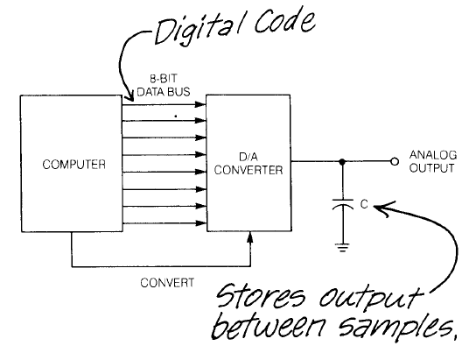
Input and Output Signal Conversion contd……

Slide 38
Input and Output Signal Conversion contd……
The D/A output generates a voltage that is proportional to the binary number in the computer output.
A low-pass filter (which could be as simple as a capacitor) is often connected across the D/A output to smooth the analog output between samples.
The sampling of the sensor output, A/D conversion, digital signal processing, and D/A conversion all take place during the time slot allotted for the measurement of the variable in a sampling time sequence.

Slide 39
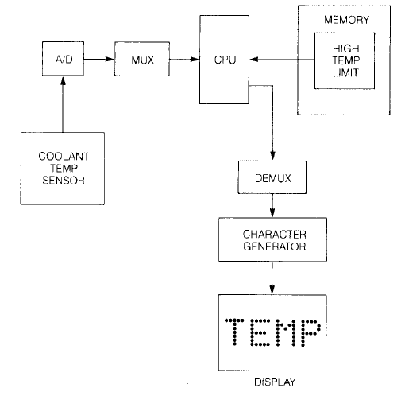
Coolant Temperature Measurement
For safe operation of the engine, the driver only needs to know that the coolant temperature is less than a critical value.
A block diagram of the measuring system is shown.

Slide 40
Coolant Temperature Measurement contd……
The sensor output voltage is sampled during the appropriate time slot and is converted to a binary number equivalent by the A/D converter.
The computer compares this binary number to the one stored in memory that corresponds to the high temperature limit.
If the coolant temperature exceeds the limit, an output signal is generated that activates the warning indicator.
If the limit is not exceeded, the output signal is not generated and the warning message is not activated.
A proportional display of actual temperature can be used if the memory contains a cross-reference table between sensor output voltage and the corresponding temperature.

Slide 41
Oil Pressure Measurement
Engine oil pressure measurement uses a warning message display rather than an indicated numerical value.
Whenever the oil pressure is outside allowable limits, a warning message is displayed to the driver.
In the case of oil pressure, it is important for the driver to know whenever the oil pressure falls below a lower limit.
It is also possible for the oil pressure to go above an allowable upper limit; however, many manufacturers do not include a high oil pressure warning in the instrumentation.

Slide 42
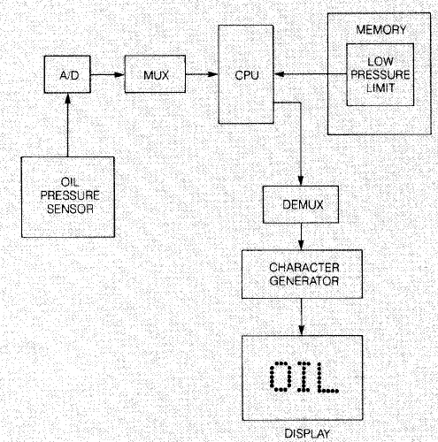
Oil Pressure Measurement contd……
An oil pressure warning system is shown in figure.

Slide 43
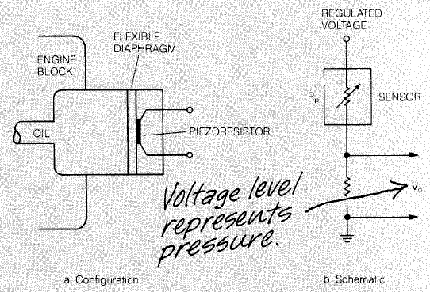
Oil Pressure Measurement contd……
This system uses a variable-resistance oil pressure sensor such as seen in the figure.

Slide 44
Oil Pressure Measurement contd……
A voltage is developed across a fixed resistance connected in series with the sensor that is proportional to oil pressure.
During the measurement time slot, the oil pressure sensor voltage is sampled through the MUX switch and converted to a binary number in the A/D converter.
The computer reads this binary number and compares it with the binary number in memory for the allowed oil pressure limits.
The oil pressure limit is determined from load or crankshaft speed measurements that are already available in the engine control system.

Slide 45
Oil Pressure Measurement contd……
These measurements serve as the address for a ROM lookup table to find the oil pressure limit.
If the oil pressure is below the allowed lower limit or above the allowed upper limit, an output signal is generated that activates the oil pressure warning light through the DEMUX.
It is also possible to use a proportional display of actual oil pressure if a cross-reference table is used.
A digital display can be driven directly from the computer.
An analog display, such as the electric gauge, requires a D/A converter.

Slide 46
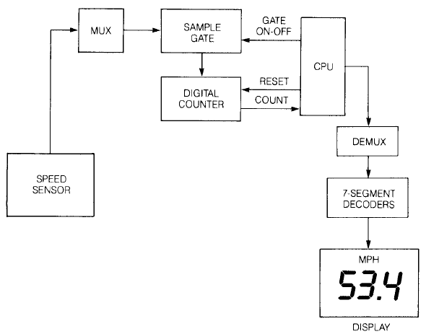
Vehicle Speed Measurement
A block diagram of the instrumentation for vehicle speed measurement that uses digital speed sensor is shown.

Slide 47
Vehicle Speed Measurement contd……
The output of the sensor is a binary number, P, that is proportional to car speed S.
This binary number is contained in the output of a binary counter.
The computer reads the number P in the binary counter, then resets the counter to zero to prepare it for the next count.
After performing computations and filtering, the computer generates a signal for the display to indicate the vehicle speed.
A digital display can be directly driven by the computer.
Either mph or kph may be selected.
If an analog display is used, a D/A converter must drive the display.
Both mph and kph usually are calibrated on an analog scale.

Slide 48
CAN Network
Automotive electronic subsystems have become numerous and interdependent, requiring subsystem intercommunication.
This need for digital communication between all on-board digital systems has led to the creation of a standard automotive communication network known as Control Area Network (CAN).
Originally developed for passenger car applications, CAN is a form of local area network that permits data to be shared.
In the CAN concept, each electronic subsystem incorporates communication hardware and software, permitting it to function as a communication module referred to as a gateway.

Slide 49
CAN Network contd……
CAN is based on the broadcast communication mechanism in which communication is achieved by the sending subsystem, transmitting messages over the network (e.g., wire interconnect).
Each message has a specific format (protocol) that includes a message identifier.
The identifier defines the content of the message and its priority.
In addition to the data and identifier, each message includes error-checking bits as well as beginning and end of file.

Slide 50
CAN Network contd……
The CAN communication system has great flexibility, permitting new subsystems to be added to an existing system without modification, provided the new additions are all receivers.
Each gateway (subsystem) can be upgraded with new hardware and software at any time with equipment that was not available at the time the car left the manufacturing plant.

Slide 51
Telematics
Communications to and from an automobile has become routine as a result of both cell phone and satellite technology.
In addition, the technology is evolving for area broadcast of road condition information on radio station subcarriers.
Technology is also evolving that will permit Internet connections via cell phones, making the car in effect on Internet node.
Automobile Internet connectivity opens a limitless range of services for the driver, from on-line navigation help to on-line diagnostic and/or road service for mechanical problems.

Slide 52
Telematics contd……
One of the major issues in telematics is, how to present the information and services that are potentially available to the driver without distracting from the driving tasks.
Of course, the various services can be made available to passengers without necessarily distracting the driver.
The simple act of dialing a standard cell phone requires the use of at least one hand and at least a momentary look at the cell phone.
Some state legislatures are passing laws prohibiting the driver’s use of a standard cell phone while driving.

Slide 53
Telematics contd……
The driver’s distraction through cell phone use can be avoided by voice-activated cell phone dialing in which the cell phone user verbally gives the phone number, speaking each digit separately.
Included within the cell phone is a very sophisticated algorithm for recognizing speech.
Speech recognition software identifies spoken words or numbers based on patterns in the waveform at the output of a microphone into which the user speaks.
There are two major categories of speech recognition software: speaker dependent and speaker independent.

Slide 54
Telematics contd……
Speaker-dependent software recognizes the speech of a specific individual who must work with the system.
The user is prompted to say a specific digit a number of times until the software can reliably identify the waveform patterns associated with that particular speaker.
By this process, the system is “trained” to the individual user.
It may not be capable of recognizing other users to whose speech it has been trained.
Speaker-independent voice recognition software can recognize spoken digits regardless of the user.
It is generally more sophisticated than speaker-dependent speech recognition.

Slide 55
Telematics contd……
The cell phone connection can also be used to provide online navigation or other services by contacting a service with operators trained to provide this type of service.
Alternately, the cell phone can be used to provide an internet connection to an on-line navigation service that transmits data to the car for display on an electronic map.
The telematics technology is certain to grow spectacularly in capability and flexibility, providing the motorist with virtually limitless services.

Slide 56
Electronic Control System Diagnostics
Each microprocessor-based electronic subsystem has the capability of performing some limited self-diagnosis.
A subsystem can detect a loss of signal from a sensor or detect an open circuit in an actuator circuit as well as other failures.
As long as the subsystem computer is still functioning, it can store fault codes for detected failures.
Such diagnosis within a given subsystem is known as on-board diagnosis.
However, a higher level of diagnosis than the on-board diagnosis is typically done with an external computer-based system that is available in a service shop.

Slide 57
Electronic Control System Diagnostics contd……
Data stored in memory in an on-board subsystem are useful for completing diagnosis of any problem with the associated subsystem.
Such diagnosis is known as off-board diagnosis and is usually conducted with a special-purpose computer.
In order for fault code data to be available to the off-board diagnosis computer, a communication link is required between the off-board equipment and the particular subsystem on-board the vehicle.
Such a communication system is typically in the form of a serial digital data link.
A serial data link transmits digital data in a binary time sequence along a pair of wires (one of which is normally ground).

Slide 58
Electronic Control System Diagnostics contd……
Inter-module communications within an automobile itself and between each on-board subsystem and an off-board system are analogous to communications between computers, i.e., they take the form of a local area network (LAN).
There are several important issues involved in any LAN, including the communication protocol, the bit rate, access to the network, and synchronization between the various subsystems.

Slide 59
Electronic Control System Diagnostics contd……
In a LAN, each subsystem connected to the serial data link is called a node.
Normally one of the nodes serves as a master that has the capability of controlling access to the network.
The other nodes are called slaves and respond to software-controlled commands issued by the master.
One of the possible problems that can occur in a LAN is the simultaneous transmission of messages by two separate nodes (called collision).
Resolution of potential collisions is controlled by the master using a software capability known as arbitration.

Slide 60
Electronic Control System Diagnostics contd……
One important application for digital communication in automobiles is the serial digital data link from the powertrain controller to an off-board diagnostic system.
This data communications link has the capability of transmitting fault codes that have been stored in memory to the external device.
This off-board system can range in complexity from a computer-based diagnostic workstation to a simple portable scanner used to simply read and display fault codes in sequence as they are retrieved over the data link from the powertrain controller.
Using these fault codes and following a fault tree diagnosis procedure, the service technician can normally diagnose powertrain control system problems.

Slide 61
On-Board Diagnostics
Limited diagnostic capability is provided in any modern microprocessor-based electronic control system.
These diagnostic functions are performed by the microprocessor under the control of stored programs, and are performed only when the microprocessor is not fully committed to performing normal control calculations.
The on-board diagnostic functions cannot detect intermittent failures reliably.
For the system to detect and isolate a failure, the failure must be nonreversible.
In most on-board diagnostics, the electronic control module stores trouble codes that are automatically cleared by the microprocessor after a set number of engine cycles have occurred without a fault reappearing.

Slide 62
Off-Board Diagnostics
An alternative to the on-board diagnostics is available in the form of a service bay diagnostic system.
This system uses a computer that has a greater diagnostic capability than the vehicle-based system because its computer is typically much larger and has only a single task to perform—that of diagnosing problems in engine control systems.
In addition to storing and displaying shop manual data and procedures, a computer-based garage diagnostic system can automate the diagnostic process itself.
In achieving this objective, the technicians’ terminal has the capability to incorporate what is commonly called an expert system.

Slide 63
Occupant Protection Systems
Occupant protection during a crash has evolved dramatically since about the 1970s.
Beginning with lap seat belts, and motivated partly by government regulation and partly by market demand, occupant protection has evolved to passive restraints and airbags.
The airbag system has a means of detecting when a crash occurs, that is essentially based on deceleration along the longitudinal car axis.
A collision that is serious enough to injure car occupants involves deceleration in the range of tens of gs (i.e., multiples of 10 of the acceleration of gravity), whereas normal driving involves acceleration/deceleration on the order of 1 g.

Slide 64
Occupant Protection Systems contd……
Once a crash has been detected, a flexible bag is rapidly inflated with a gas that is released from a container by electrically igniting a chemical compound.
Ideally, the airbag inflates in sufficient time to act as a cushion for the driver (or passenger) as he or she is thrown forward during the crash.
At car speeds that can cause injury to the occupants, the time interval for a crash into a rigid barrier from the moment the front bumper contacts the barrier until the final part of the car ceases forward motion is substantially less than a second.
A typical airbag will require about 30 msec to inflate, meaning that the crash must be detected within about 20 msec.

Slide 65
Occupant Protection Systems contd……
With respect to the speed of modern digital electronics, a 20 msec time interval is not considered to be short.
The complicating factor for crash detection is the many crash-like accelerations experienced by a typical car that could be interpreted by airbag electronics as a crash, such as impact with a large pothole or driving over a curb.
The configuration for an airbag system has also evolved from electromechanical implementation using switches to electronic systems employing sophisticated signal processing.

Slide 66
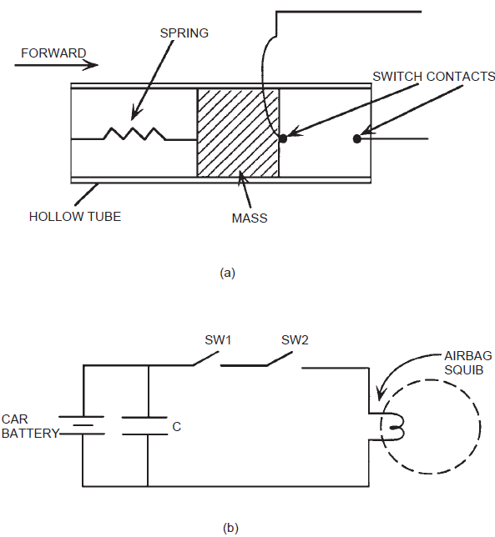
Occupant Protection Systems contd……
One of the configurations employed a pair of acceleration switches SW1 and SW2 as shown.
Each of these switches is in the form of a mass suspended in a tube with the tube axis aligned parallel to the longitudinal car axis.
The two switches, which are normally open, must both be closed to complete the circuit for firing the airbag.
When this circuit is complete, a current flows through the ignitor that activates the charge.
A gas is produced (essentially explosively) that inflates the airbag.

Slide 67
Occupant Protection Systems contd……
The switches SW1 and SW2 are placed in two separate locations in the car.
Typically, one is located near the front of the car and one in or near the front of the passenger compartment.
Under normal driving conditions, the spring holds the movable mass against a stop and the switch contacts remain open.
During a crash, the force of acceleration (actually deceleration of the car) acting on the mass is sufficient to overcome the spring force and move the mass.

Slide 68
Occupant Protection Systems contd……
For sufficiently high car deceleration, the mass moves forward to close the switch contacts.
In a real collision at sufficient speed, both switch masses will move to close the switch contacts, thereby completing the circuit and igniting the chemical compound to inflate the airbag.
Figure (b) also shows a capacitor connected in parallel with the battery.
This capacitor is typically located in the passenger compartment.
It has sufficient capacity that in the event the car battery is destroyed early in the crash, it can supply enough current to ignite the squib.

Slide 69
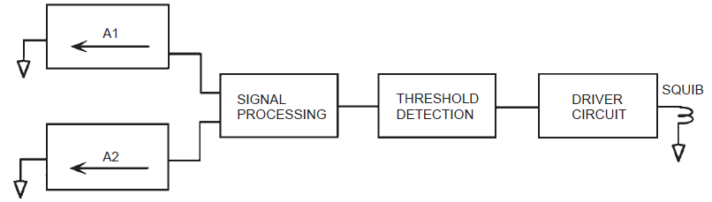
Occupant Protection Systems contd……
In electronic airbag systems, the role of the acceleration-sensitive switch is played by an analog accelerometer along with electronic signal processing, threshold detection, and electronic driver circuit to fire the squib.
Figure shows a block diagram of such a system.

Slide 70
Occupant Protection Systems contd……
The accelerometers A1 and A2 are placed at locations similar to where the switches SW1 and SW2 are located.
Each accelerometer outputs a signal that is proportional to acceleration (deceleration) along its sensitive axis.
Under normal driving conditions, the acceleration is less than 1 g.
However, during a collision at a sufficiently high speed, the signal increases rapidly.
Signal processing can be employed to enhance the collision signal in relation to the normal driving signal.
Such signal processing must be carefully designed to minimize time delay of the output relative to the collision deceleration signal.

Slide 71
Occupant Protection Systems contd……
After being processed, the deceleration signal is compared with a threshold level.
As long as the processed signal is less than this threshold, the driver circuit remains deactivated.
However, when this signal exceeds the threshold, the driver circuit sends a current of sufficient strength to activate the chemical and inflate the airbag.
Typically, the threshold is set so that airbag deployment occurs for a crash into a barrier at or above a specific speed.
Depending on the system design, this speed can be anywhere between 8 and 12 mph.
This speed range is chosen by the manufacturer to optimize the protection offered to the car occupants while minimizing false deployment (that is, deployment when there is no crash).

Slide 72
Occupant Protection Systems contd……
In addition to airbags for protecting the driver and front seat passenger against frontal collision, airbags have become available for occupant protection against other types of collisions.
Airbags now are available for protection against side impact.
There will continue to be new developments in airbag technology in order to improve performance.
There is one class of signal for a crash into a rigid barrier (i.e., a nonmoving and incompressible object) and another for a crash between a pair of cars (particularly when vehicle curb weights are different).
In spite of technical difficulties in implementation, the airbag is finding broad application for occupant protection and has achieved broad acceptance by the driving public.

